Slide 1
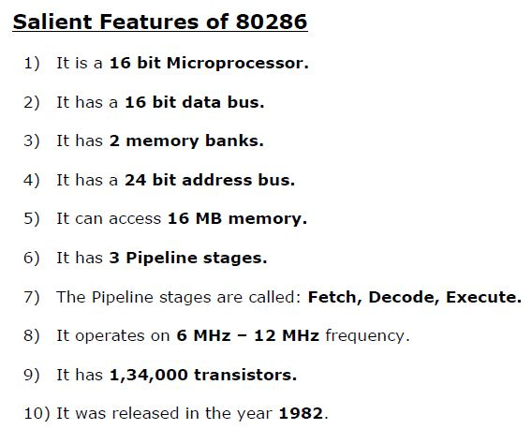
Microprocessor

Slide 2
80286- Register Organization
80286 contains almost the same set of registers as in 8086
Eight 16 bit general purpose registers (AX, BX, CX, DX, BP, SP, SI, DI)
Four 16 bit segment registers
Status and control registers (Flag Resgister)
Instruction Pointer

Slide 3
80286- Register Organization
AH | AL
BH | BL
CH | CL
DH | DL
CS
DS
SS
ES
BP
SI
DI
SP
General purpose registers Segment Registers

Slide 4
80286- Internal Block Diagram
Contains 4 functional parts:
1) Address Unit(AU)
2) Bus Unit (BU)
3) Instruction Unit (IU)
4) Execution Unit (EU)

Slide 5
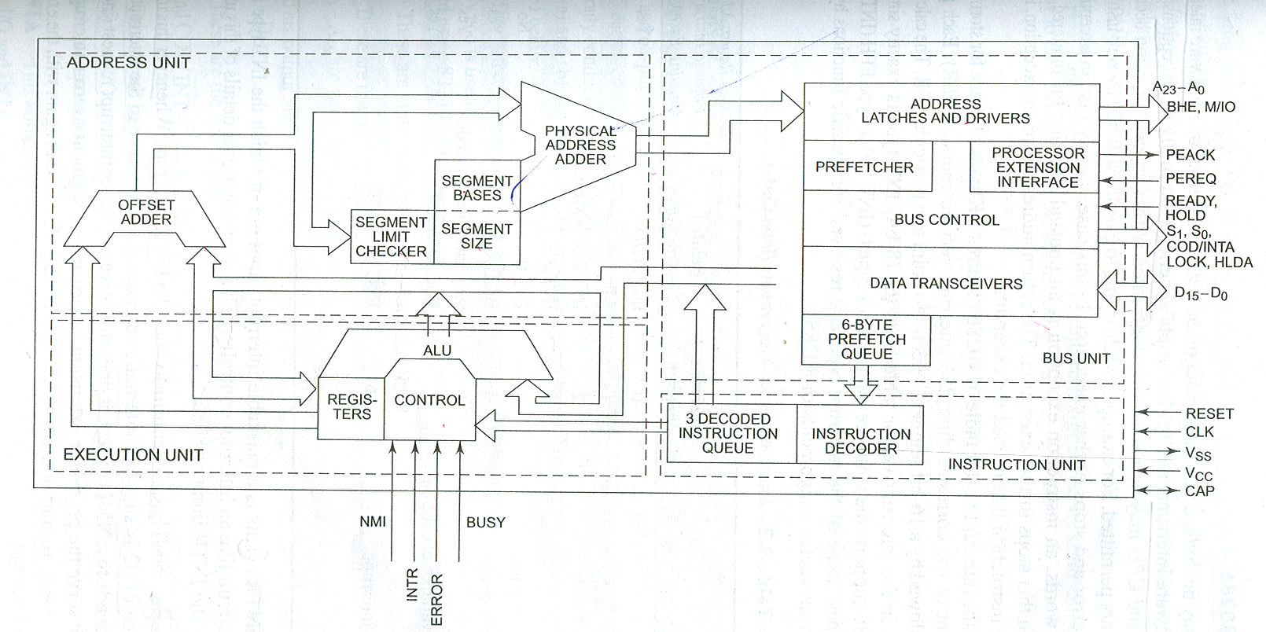
80286 Internal Block Diagram

Slide 6
Address Unit(AU) :
Responsible for calculating the physical address of instructions and data that the CPU wants to access
Address lines derived by this unit may be used to address different peripherals

Slide 7
Bus Unit (BU) :
Physical address computed by AU is handed over to BU
BU transmit this physical address over the address bus A0 – A23
BU fetch instruction bytes from memory
When one instruction is getting executed, the subsequent instruction is prefetched, decoded and kept ready for execution (instruction pipelining)
This task is done by the prefetcher module in the Bus Unit
These fetched instructions are arranged in a 6 byte prefetch queue

Slide 8
Instruction Unit (IU) :
IU accepts instructions from the prefetch queue and an instruction decoder decodes them one by one
The decoded instructions are stored in a decoded instruction queue

Slide 9
Execution Unit (EU) :
Output of decoding circuit drives a control circuit in EU
It is responsible for executing the instructions received from the decoded instruction queue
EU contains the register bank and ALU
ALU is the heart of EU, which carries out all the arithmetic and logical operations and sends the results either over the data bus or back to the register bank

Slide 10
Microprocessor
Salient Features of 80386
1) It is a 32 bit Microprocessor.
2) It has a 32 bit data bus.
3) It has 4 memory banks.
4) It has a 32 bit address bus.
5) It can access 4 GB memory.
6) It has 3 Pipeline stages.
7) The Pipeline stages are called: Fetch, Decode, Execute.
8) It operates on 16 MHz – 33 MHz frequency.
9) It has 2,75,000 transistors.
10) It was released in the year 1985.

Slide 11
80386 Architecture

Slide 12
Microprocessor
80386 architecture is divided into 5 independent units.
Bus Unit (Bus Interface Unit)
1) The Bus unit is responsible for transferring data in and out of the μP.
2) It is connected to the external memory and I/O devices, using the system bus.
3) It gets requests from Prefetch unit for fetching instructions and from execution unit for transferring data.
4) If both requests occur simultaneously preference is given to execution unit.

Slide 13
Microprocessor
Prefetch Unit
1) The Pre-fetch unit fetches further instructions in advance to implement pipelining.
2) It fetches the next 16 bytes of the program and stores it into the Prefetch Queue.
3) It refills the queue when at least 4 bytes are empty as 80386 has a 32 bit data bus.
4) During a branch, the instructions in the queue are invalid and hence are discarded.

Slide 14
Microprocessor
Decode Unit
1) 80386 μP has a separate unit for decoding instructions called the Decode Unit.
2) It decodes the next three instructions and keeps them ready in the Decode Queue.
3) The decoded instructions are stored in Micro-Coded form.
4) During a branch, the instructions in the queue are invalid and hence are discarded.

Slide 15
Microprocessor
Execution Unit
1) Execution Unit performs the main task of executing instructions.
2) Normally, execution requires Arithmetic or Logic operations performed by a 32-bit ALU.
3) It also has dedicated circuits for 32-bit multiplication and division.
4) A 64-bit barrel shifter is also provided for faster shifts during multiplication and division.
5) Operands for the ALU can either be provided in the instruction, or can be taken from memory
or could be taken from the 32-bit registers like EAX, EBX etc.
6) Additionally there is a 32-bit Flag register (EFLAGS) giving the Status of the current result.

Slide 16
Microprocessor
Memory Unit
1) The Memory unit converts Virtual Address (Logical address) to Physical Address.
2) 80386 μP implements 64 Terra bytes of Virtual memory using Segmentation and Paging.
Hence the Memory Unit is sub-divided into Segmentation Unit and Paging Unit.
3) Segmentation is compulsory, while Paging is optional.
4) The Segmentation Unit converts the Logical Address into a Linear Address.
5) The Paging Unit converts the Linear Address into a Physical Address.
6) If Paging is not used, then the Linear Address itself is the Physical Address.

Slide 17
Microprocessor

Slide 18
Microprocessor

Slide 19
Microprocessor

